Slide 1
Employee Data Analysis using Excel
STUDENT NAME: P.POOJA
REGISTER NO: 312216115 & asunm1621312216115
DEPARTMENT: B.COM (ACCOUNTING & FINANCE)
COLLEGE: SHRI SHANKARLAL SUNDARBAI SHASUN JAIN COLLEGE FOR WOMEN

Slide 2
PROJECT TITLE
Employee Performance Analysis using Excel

Slide 3


AGENDA
Problem Statement
Project Overview
End Users
Our Solution and Proposition
Dataset Description
Modelling Approach
Results and Discussion
Conclusion
3/21/2024 Annual Review

Slide 4

PROBLEM STATEMENT
Employees Performance analysis is an essential aspect of managing any business and, if done correctly, can help management teams use data analysis to their advantage to further business growth. Different crucial decisions like bonuses, pay raises, promotions, etc. are taken based on the performance evaluation of the employees in a company or organization. These are some reasons to analyse the employees performance level

Slide 5

PROJECT OVERVIEW
.
Analysing the performance level of employees considering various factors like gender, performance score, ratings, achievements and their contribution to the company. By this way we will be able to know how many employees are well-versed in their work and who needs improved, so that they can be motivated. This states the employees contribution level.

Slide 6
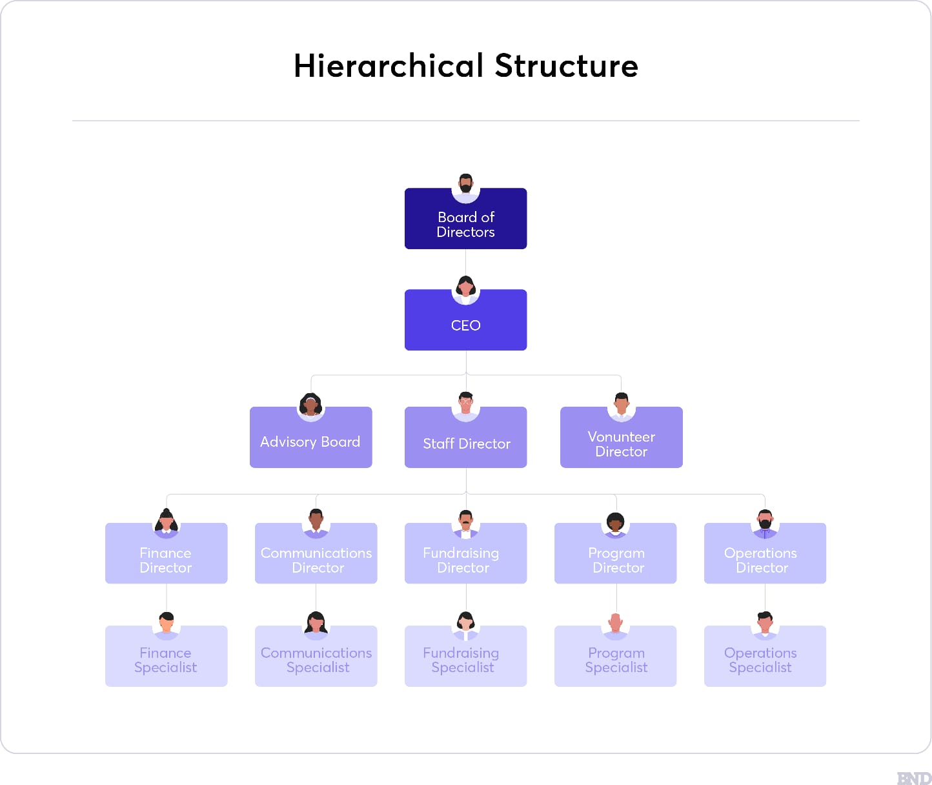

WHO ARE THE END USERS?
The end users are the people in the hierarchy structure of the company like, manager, CEO, Managing director, Board members of that particular company.

Slide 7

OUR SOLUTION AND ITS VALUE PROPOSITION
Conditional Formatting - To highlight the missing values
Filter - To remove the missing values
Formulas - To calculate employees performance level from numeric to alphabetic
Pivot Table - To make the summary of the selected value
Slicer - Used to view one particular information from all over
the data.
Graph - To visualize the data in the most easier format

Slide 8
Dataset Description
Employees - IBM EDUNET
Available features - 26
Considered features - 9
1. Emp ID - Numeric
2. First Name - Text
3. Last Name - Text
4. Employee Type
5. Gender - Male/Female
6. Performance score
7. Employee Rating - Numeric
8. Business Unit
9. Employee Status

Slide 9

THE "WOW" IN OUR SOLUTION
I have created a new coloumn named performance level to update the employee ratings that was in the numeric form to text form using a fromula “=IFS(Z8>=5,"VERY HIGH",Z8>=4,"HIGH",Z8>=3,"MED",TRUE,"LOW")”. This shows the numeric rating in the text form with the name 1. very high
2. high
3. medium
4. low
3/21/2024 Annual Review
‹#›

Slide 10
MODELLING
Data collection
1.Data set from Edunet Dashboard
Features collection
collected 26 features from dataset
only 9 features were taken into consideration
1. Emp ID - Numeric
2. First Name - Text
3. Last Name - Text
4. Employee Type
5. Gender - Male/Female
6. Performance score
7. Employee Rating - Numeric
8. Business Unit
9. Employee Status
‹#›

Slide 11
Data cleaning
Used conditional formatting to highlight the blank coloumns. And,
Filter option is used to remove the highlighted coloumns
Performance level
Identifed the employees performance level by creating a new formula by using the coloumn called employee rating
The formula is - “=IFS(Z8>=5,"VERY HIGH",Z8>=4,"HIGH",Z8>=3,"MED",TRUE,"LOW")”
Summary
Summarized by use of Pivot tables
adding
1. business unit to the rows
2. performance level to the coloumn
3. gender to the filter
4. first name to the values

Slide 12
Data Vizualization
done using
1. bar graph
trend lines are used to differentiate the rating of the employee
2. pie chart
business units are used to differentiate employee type
The results are shown below

Slide 13
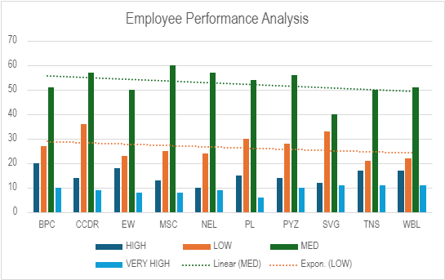
RESULTS
‹#›

Slide 14
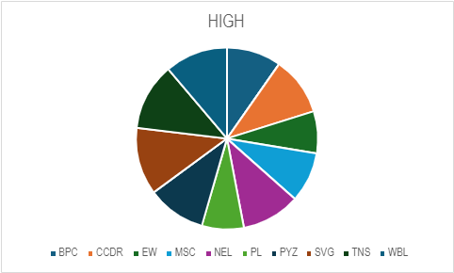
RESULTS

Slide 15
conclusion
While comparing the performance of employees, the number of average performer of employees are higher in the organisation that is, “medium” level of employees.
The number of employees in “very high” and “high” category are very low.
So, the conclusion is to motivate the employees more, as they will be able to reach the “very high” and “high” category. by doing so the employees will thrive in their roles and flourish as individuals and the growth of the company will be massive.

